Slide 1
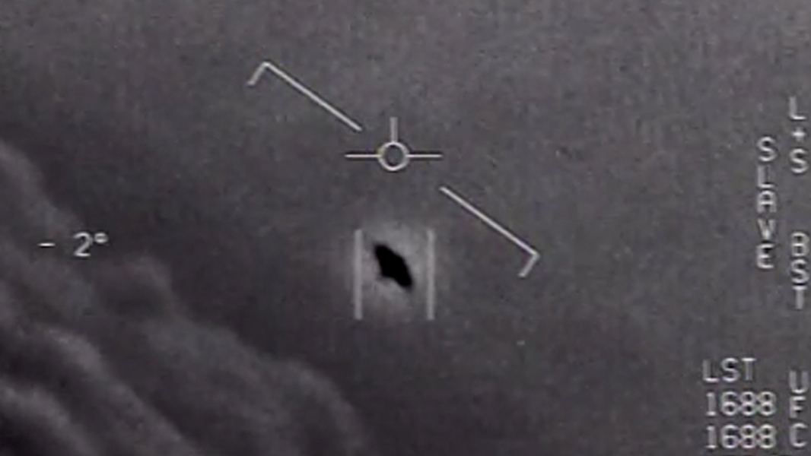
UFO Sightings
Final Project by Kevin, Duy, Justin and Yvonne
Notes:
Hello fellow Data Analytics cohorts. Thank you for allowing us to present to you our final project. Our team went with with a data set of UFO Sightings. This is phenomenon that has baffled many and astonished those who have encountered these instances. The background picture represents a screenshot of the three clips of declassified military footage released from the U.S. Navy in 2017 and 2018, which the U.S. Navy described as “unidentified aerial phenomena”. We hope you enjoy what we have to present to you. Our team consisted of Kevin, Duy, Justin and Yvonne as per usual.

Slide 2

PROPOSAL
Where do UFO Sightings occur?
Do they occur at a specific time/time of year?
What do people report seeing?
Can we predict w/ ML when additional sightings will occur?
Notes:
The aim of our project was to discover where UFO sightings occurred, determine if UFO sighting occur in more locations than others and to use ML to determined predictive analysis with this UFO dataset. We also hope you enjoy the colorful and alien inspired pictures and backgrounds we have included in each slide of this presentation.

Slide 3

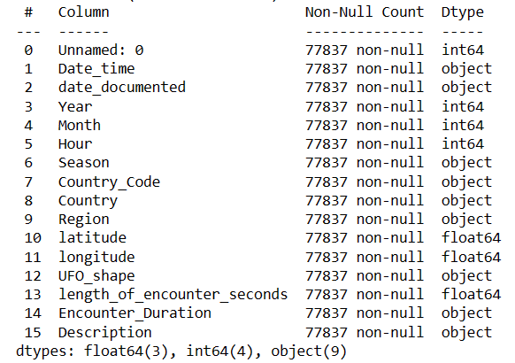
Cleaned UFO Data
Original data contained 80328 rows
Cleaned data contained 77837 rows
Notes:
To start off we pulled our dataset from Kaggle. In the bottom right hand corner, you can see that our data originally contained 80,328 rows and after cleaning the data, which we all know is a vital step in data analytics, we ended up with 77,837 rows, which we thought was a fair trade off to start with clean data. In the big box in the center, you can see the columns we had to work with and the data types for each.

Slide 4
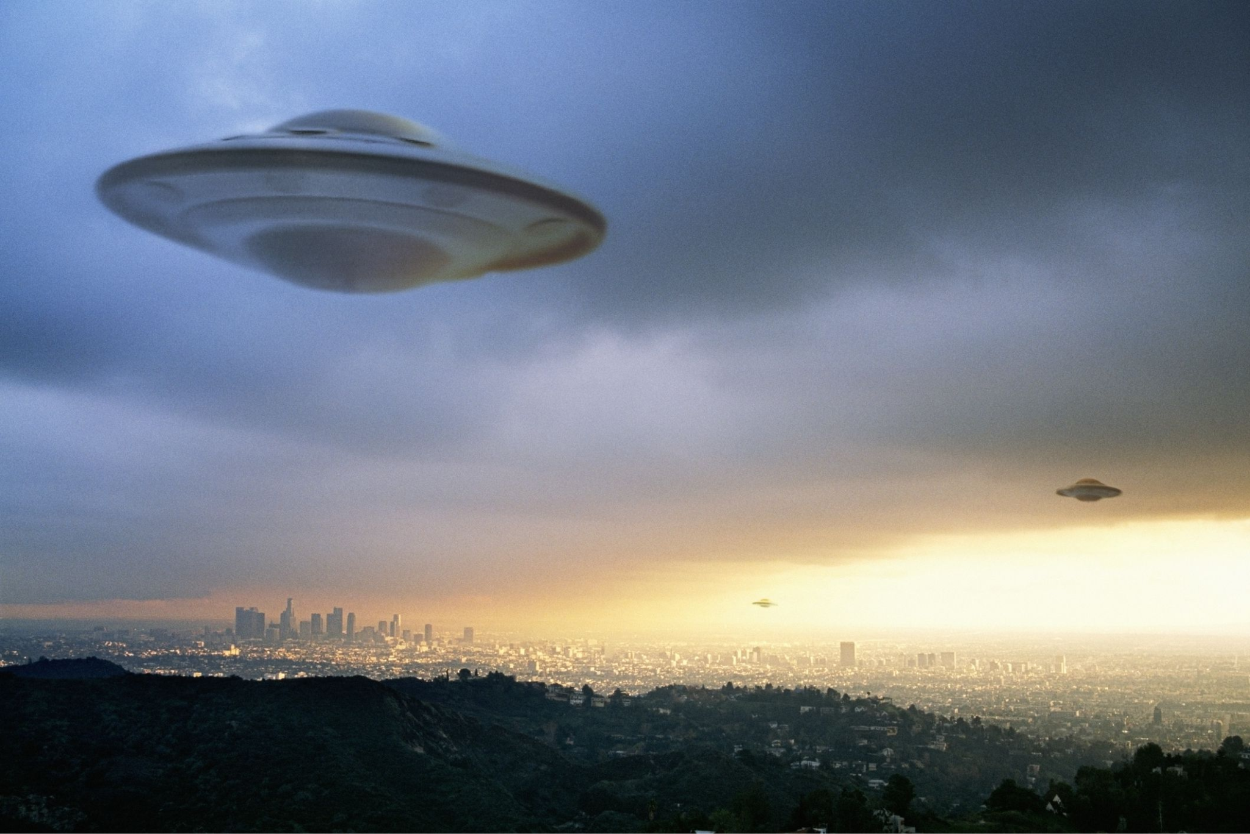
Initial Analysis
Data contained sightings from 1910-2014
Total UFO sightings from 1910 to 1996: 8661
Total UFO sightings from 1997 to 2014: 69176
Countries with most UFO sightings: United States (69139), followed by Canada (3530), United Kingdom (2289), Australia (586) and India (211)
Top 5 States with most UFO sightings: California (9374), Florida (4108), Washington (3989), Texas (3629), New York (3167)
Notes:
In conducting initial analysis for our data, we found that the data set contained UFO sightings starting in 1910 and dropping off in 2014. We thought that the data set ending in 2014, instead of continuing on until present day, or at least until the early 2000’s was interesting. Unfortunately, we couldn’t discover why the data set stopped recording UFO sightings. We also discovered that starting in 1997, the data sharply increased. Additionally, for the entirety of the data set, most UFO sightings occurred within the United States and the state that had the most UFO sightings was California, followed by Florida, Washington, Texas and New York.

Slide 5
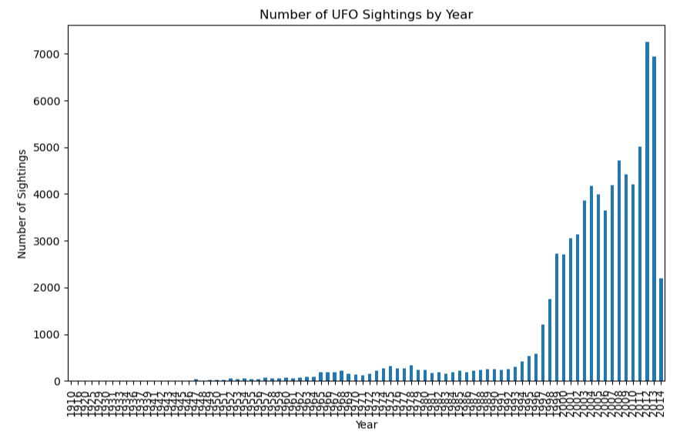
Number of UFO Sightings by Year - starting in 1910
1997
Notes:
This bar graph represents the number of UFO sightings by year and visually depicts the drastic increase in UFO sightings starting in 1997. The only conclusion we could come with for the drastic increase starting in 1997 from extensive online research, was that in March 1997, a number of Arizona residents said they witnessed a large flying object in the sky near Phoenix, now known as the Phoenix Lights incident. This incident was recorded in a bestselling book, “The Phoenix Lights … A Skeptic’s Discovery That We Are Not Alone and in 2005 was made into a critically acclaimed, internationally award winning Documentary knows as the The Phoenix Lights. You should check it out next time your bored.

Slide 6
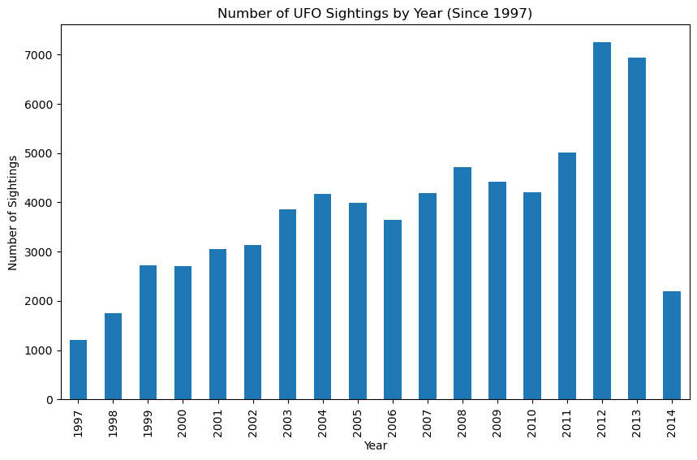
Number of UFO Sightings by Year - starting in 1997
Notes:
The bar graph represents the number of UFO sightings starting in 1997, the year that UFO sightings drastically increased. This bar graph seems to be a little bit more normalized minus the increase we see in 2012 and 2013 and then the drastic drop in 2014, which is where our data mysteriously drops.

Slide 7
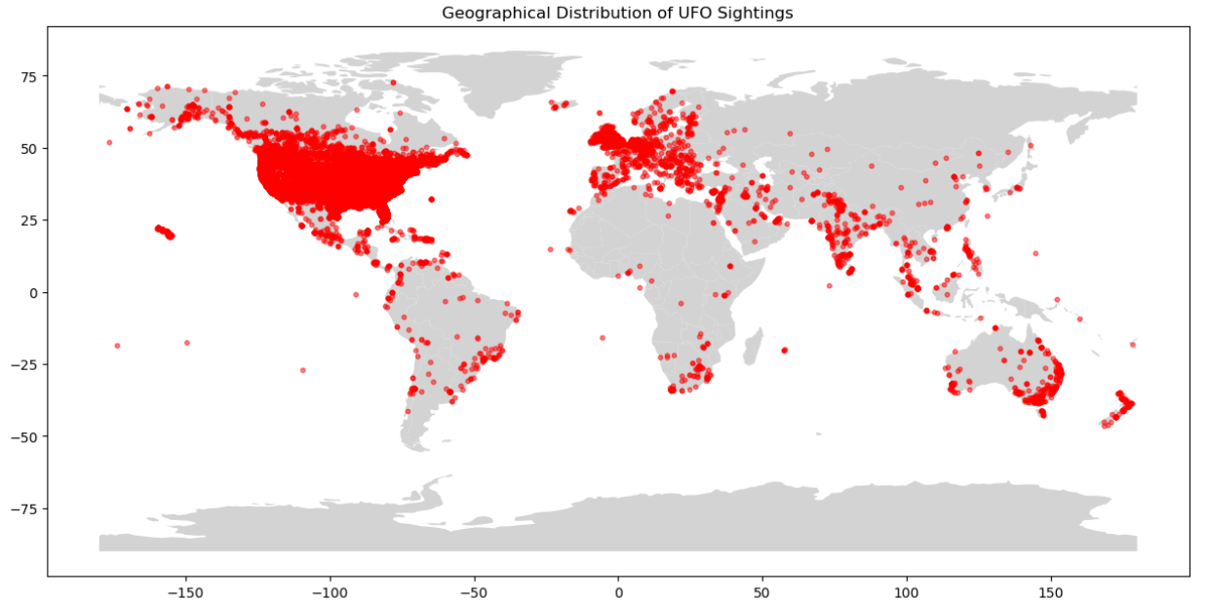
Where do UFO Sightings occur?
Notes:
So, Where DO UFO sightings occur. This graphic depictions shows a red dot for every UFO sighting on record from 1910 through 2014. We thought about depicting this representation with a heat map, but as you can tell, that wasn’t necessary. The United States clearly represents the majority of UFO sightings.

Slide 8
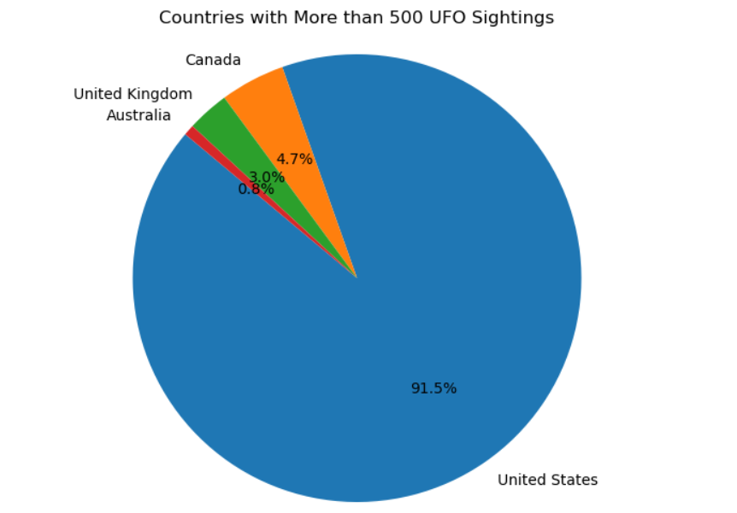
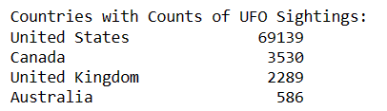
Notes:
And again, this pie chart represents countries with more than 500 UFO sightings. The United States is the clear forerunner with 69,139 sightings and Canada, the United Kingdom and Australia trailing with dismal sightings reported.

Slide 9

It seems UFO sightings are prevalent in the United States, perhaps we should set a seat for them at the table
Notes:
PAUSE to let the audience read the slide. This slide is purely for humor and meant only to provide a hardy har laugh.

Slide 10

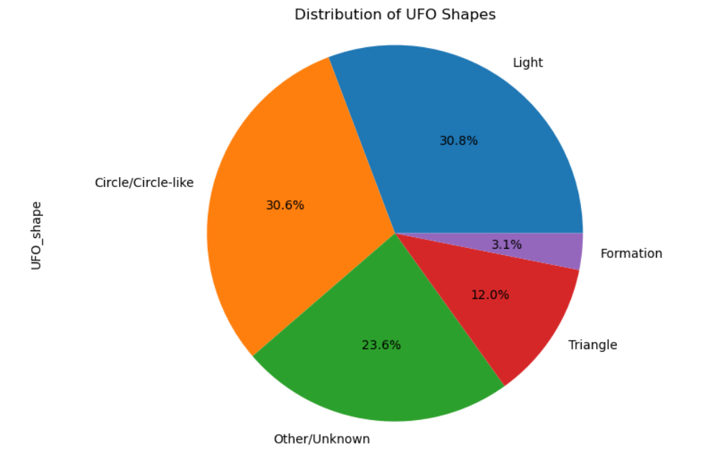
What do people report seeing?
Notes:
So, what do people report seeing when they report UFO sightings? In our data cleaning, we combined like shapes to provide a more concise depiction of what is generally seen when reporting UFO sightings. The picture to the right was our attempt to visually display the majority of UFO sightings, which is light at 30.8% and circle or circle like shapes at a close 30.6%.

Slide 11

UFO Sightings and Machine Learning
Notes:
UFO sightings and machine learning. This background picture hopefully combines both UFO sightings and machine learning!!

Slide 12
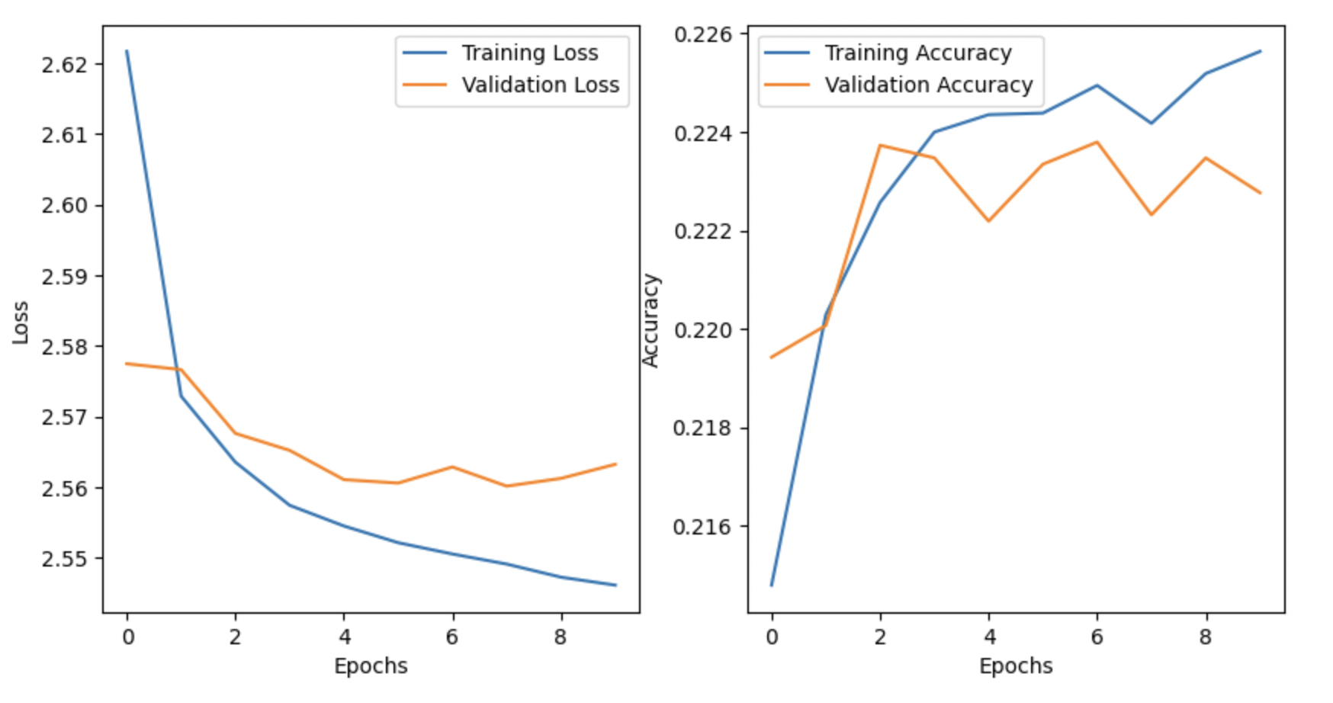
Neural Net to Predict UFO Shape

Slide 13
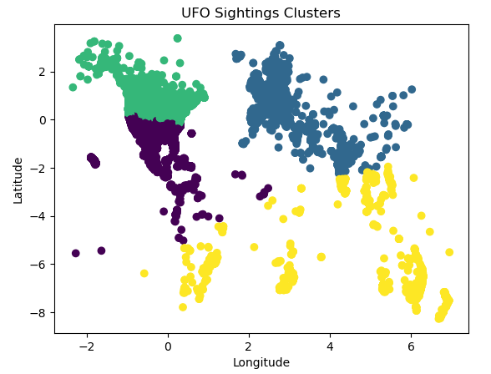
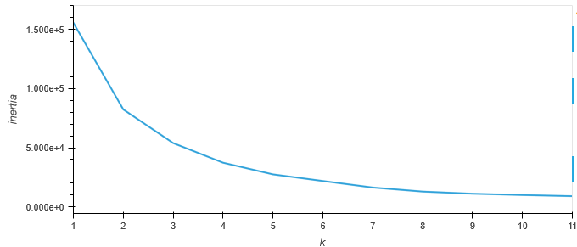
UFO ML Predict Regions for next UFO sighting
- Extracted lat and long as features
- Number of clusters: 4
- Apply K-Means clustering
Notes:
In our machine learning phase of UFO sightings, we decided to see if we could use machine learning to predict the next UFO sighting. We extracted the lat and long as features, chose a random number of clusters as 5 and applied K-means to our clusters. The graphic depiction on the right, shows these clusters.

Slide 14
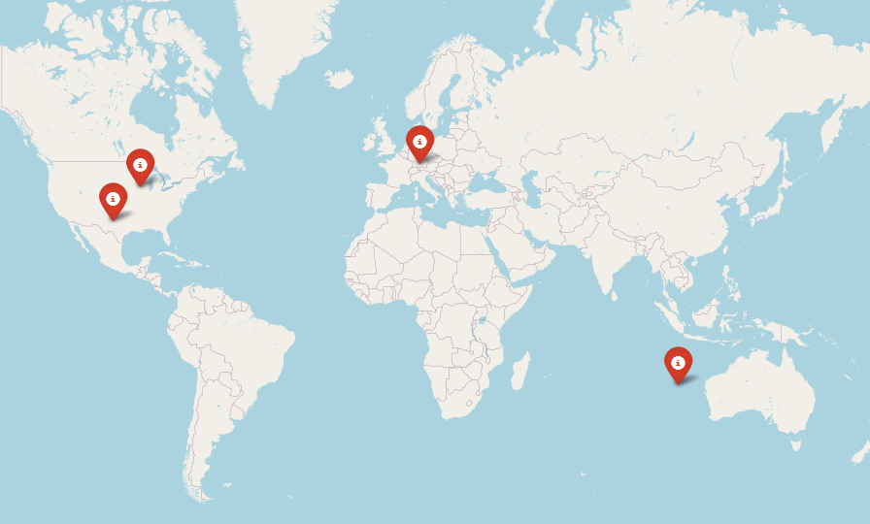
UFO ML: Hotspot of Clusters Identified
List of Hotspots:
Cassville, Wisconsin
Clairemont, Texas
Gerstetten, Germany
Indian Ocean
Notes:
Machine learning provided the mean for our clusters within Wisconsin, Texas, Germany, and the Indian Ocean. However, we concluded that our ML predictions for the next location for a UFO sightings are likely incorrect. Our own analytic thought process leads us to believe the next UFO sighting would likely be in the U.S. and in California or Florida.

Slide 15

Conclusions: UFO Sightings
– Interesting Note: Sighting data fell off in 2014, hmmmm
– UFO sightings much more prevalent in U.S., specifically California and Florida, hmmmm
– ML predictions provided results for locations for possible next sightings.
LOOK UP and QUESTION what you see!!!!!
–
Notes:
In conclusion, we are still questioning why our dataset fell off in 2014. We are also concerned that our data set seems to indicate that most sightings occur in California and Florida, which are also where many interesting people live. Our machine learning results provided locations for possible next sightings and during which season those sightings might occur. Thank you for your attention and we encourage our classmates to keep looking up and always question what you see.

